Slide 1
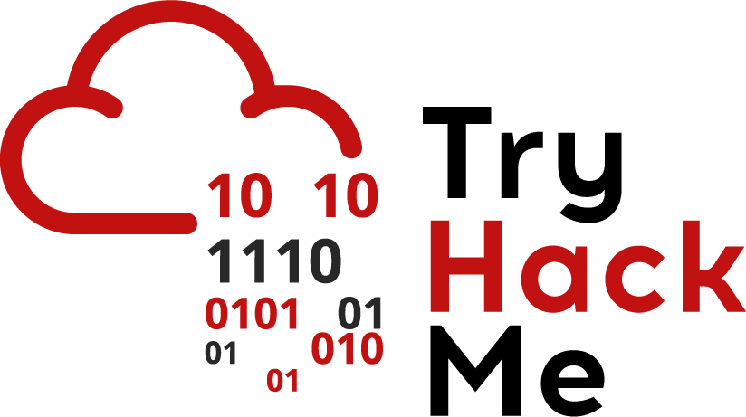


Cyber Kill Chain
Eng. Mahmoud Hassan

Slide 2
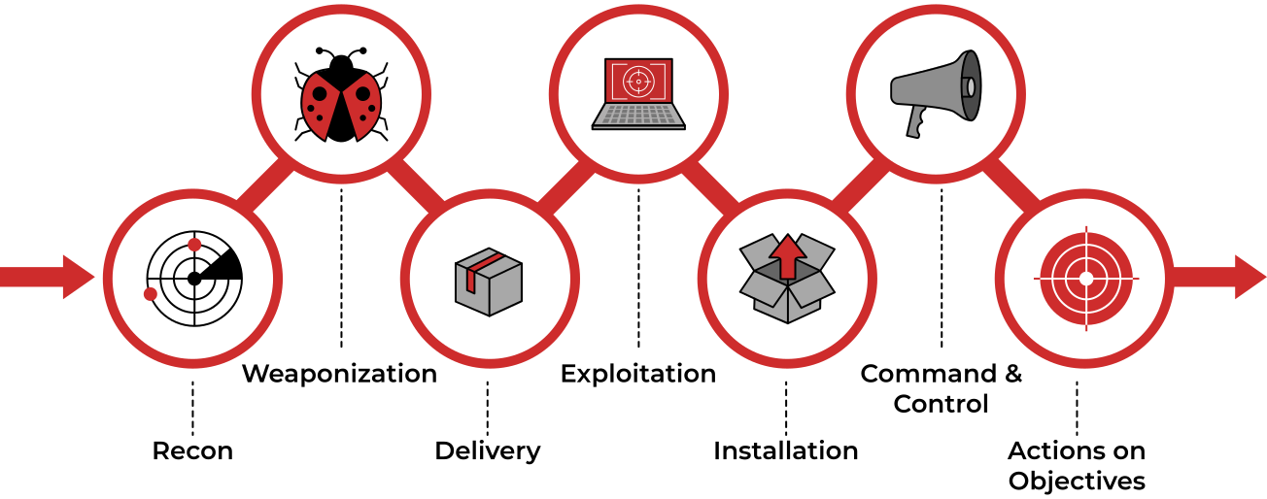
Cyber Kill Chain

Slide 3
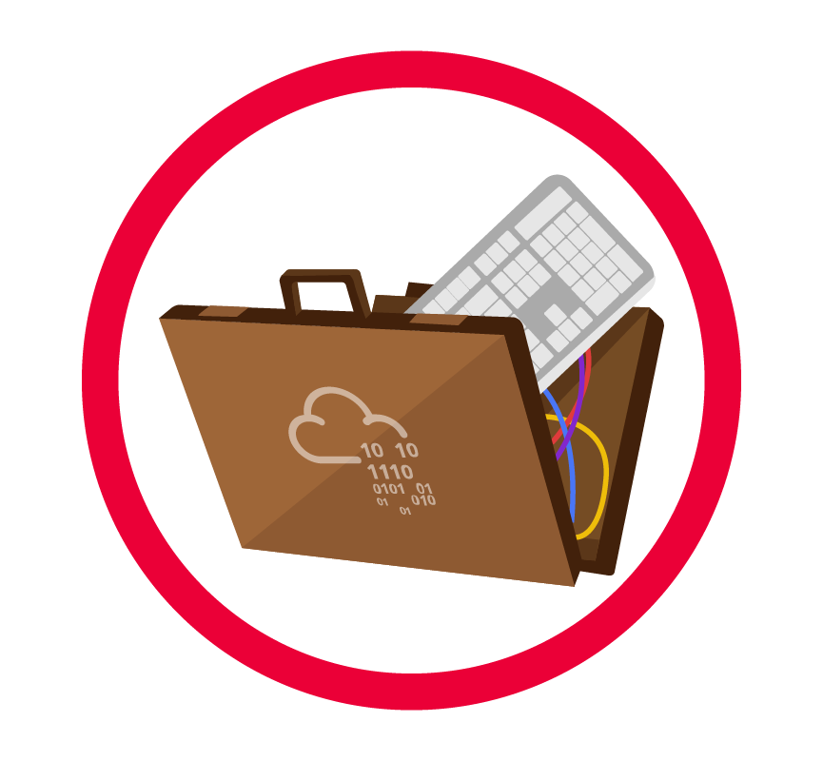


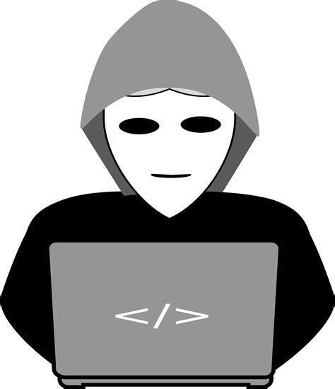
Delivery
The Delivery Phase:
In this phase, the attacker decides on the method he will use to deliver the malicious payload or malware to the victim. There are several methods to choose from, and we’ll explore some of them here:
1. Phishing Emails: After completing the reconnaissance phase and identifying the targets, the attacker crafts a malicious email containing the payload. This email can target a specific individual or multiple people within the company.
Example:
Nancy
Sales at Company A
Scott
Service Delivery Manager at Company B
Megatron
The Hacker

Slide 4
Delivery
Example:
"Megatron" notices that "Nancy" from the Sales department at Company A frequently likes posts by "Scott," a Service Delivery Manager at Company B, on LinkedIn.
Based on this, "Megatron" guesses that they communicate via work email.
He creates an email using Scott’s name and makes the domain look similar to Scott’s company domain.
He sends an email to Nancy with the subject "Invoice" that contains the malicious payload.

Slide 5
Delivery
The Delivery Phase:
There are several methods to choose from, and we’ll explore some of them here:
2. Distributing Infected USB Drives: The attacker distributes USB drives infected with malware in public places like coffee shops, parking lots, or streets. These attacks can be more sophisticated. such as, Printing the target company’s logo on the USB drives and mailing them to the company, pretending to be a customer sending a gift. After the employes put USB in his computer it will be infected.
3. Watering Hole Attacks: This type of attack targets a specific group of people by compromising a website they frequently visit. After hacking the website, victims are redirected to a malicious website containing malware.

Slide 6



Thank you
+201116735630
mahmoudhassan2947@gmail.com
www.linkedin.com/in/mahmoud-hassan-b4400b1b7

